Slide 1


SOFTWARE ENGINEERING
CLASS CC01 - GROUP 01

Slide 2
MEMBERS
1. Bùi Phạm Thái An – 2052358
2. Cao Quế Phương – 2252652
3. Đặng Duy Tiến – 2252808
4. Đào Thị Hà An – 2252002
5. Đinh Bá Khánh – 2252323

Slide 3
INTRODUCTION
Purpose: Streamline document printing for students across HCMUT campuses.
Features:
Upload and print documents with customizable properties.
Manage printing accounts with default and purchasable page quotas.
Monitor and review printing history and usage.

Slide 4

STAKEHOLDERS & KEY BENEFITS
Stakeholder: students, Student Printing Service Officer (SPSO)
Key benefit:
Hassle-free, on-campus printing.
Controlled usage and account management.
Automated reporting for enhanced system oversight.

Slide 5

FUNCTIONAL & NON-FUNTIONAL REQUIREMENT
Funtional requirements
Student:
Print document
View printing log
View page balance
Buy more page
SPSO:
View student printing history
Manage printers
Manage files type
View periodical reports

Slide 6
FUNCTIONAL & NON-FUNTIONAL REQUIREMENT (CONT.)
Non-funtional requirements
Implemented as web-base and mobile application
Available 24/7, except for maintenance period
Available for concurrent 100 000 users
Each printer serves only 1 user per time
All users must be authenticated before
Payment method is made online

Slide 7
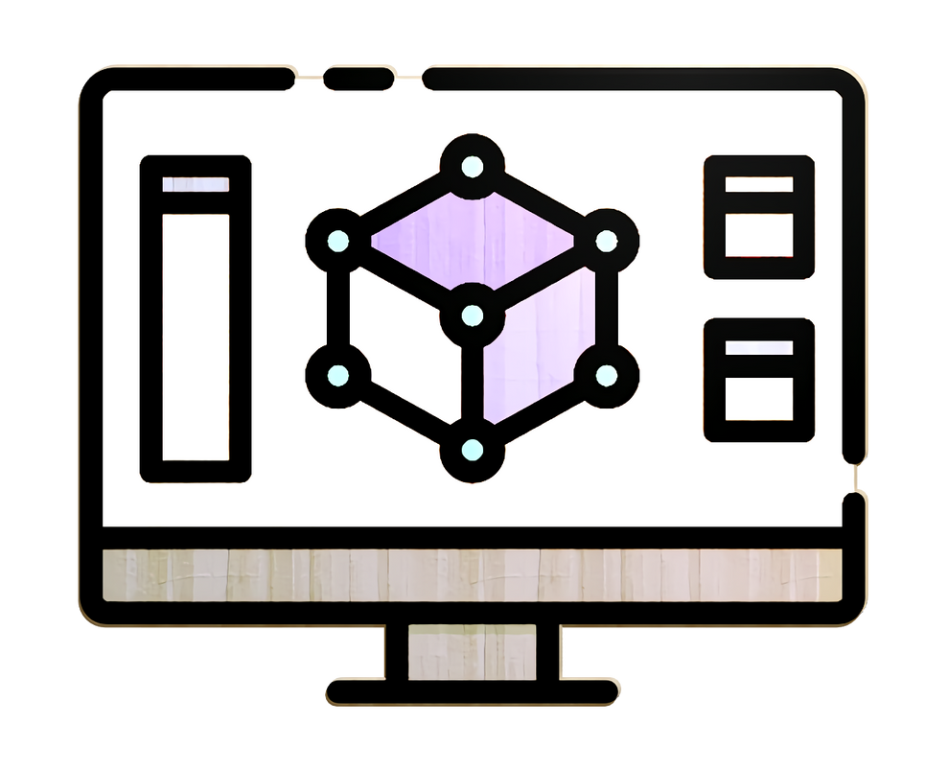
SYSTEM MODELING
Use case diagram
Activity diagram
Sequence diagram
Class diagram

Slide 8
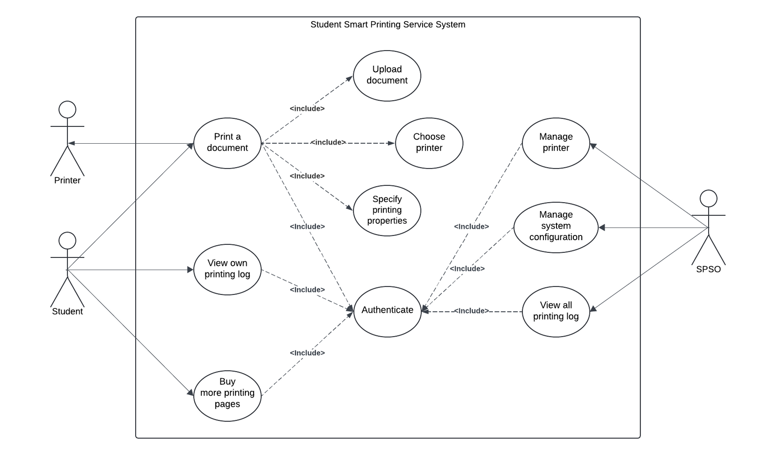
SYSTEM USECASE DIAGRAM

Slide 9
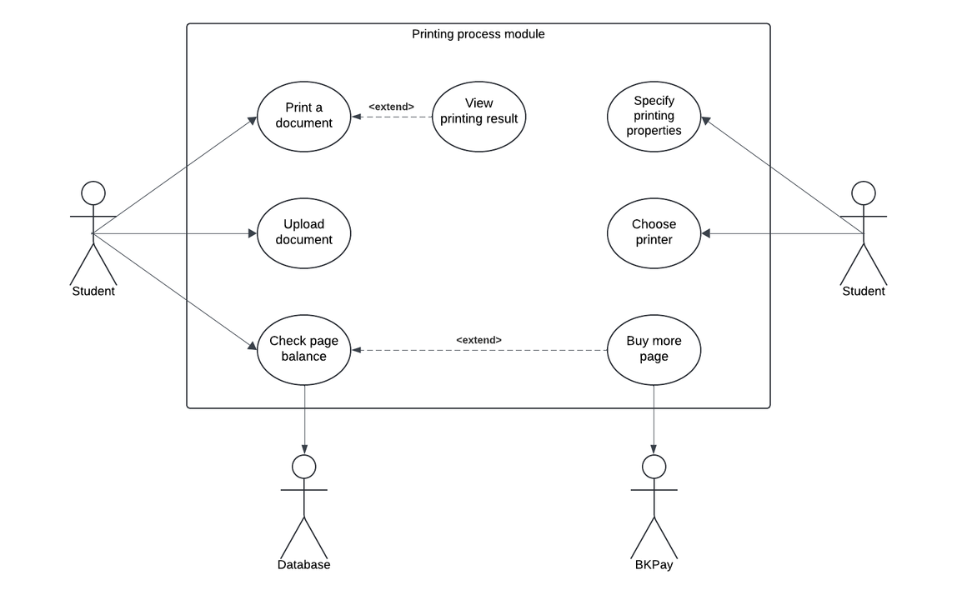
PRINTING PROCESS USECASE
Details:
Print a document
Upload document
Specify printing properties
Choose printer
Check page balance

Slide 10
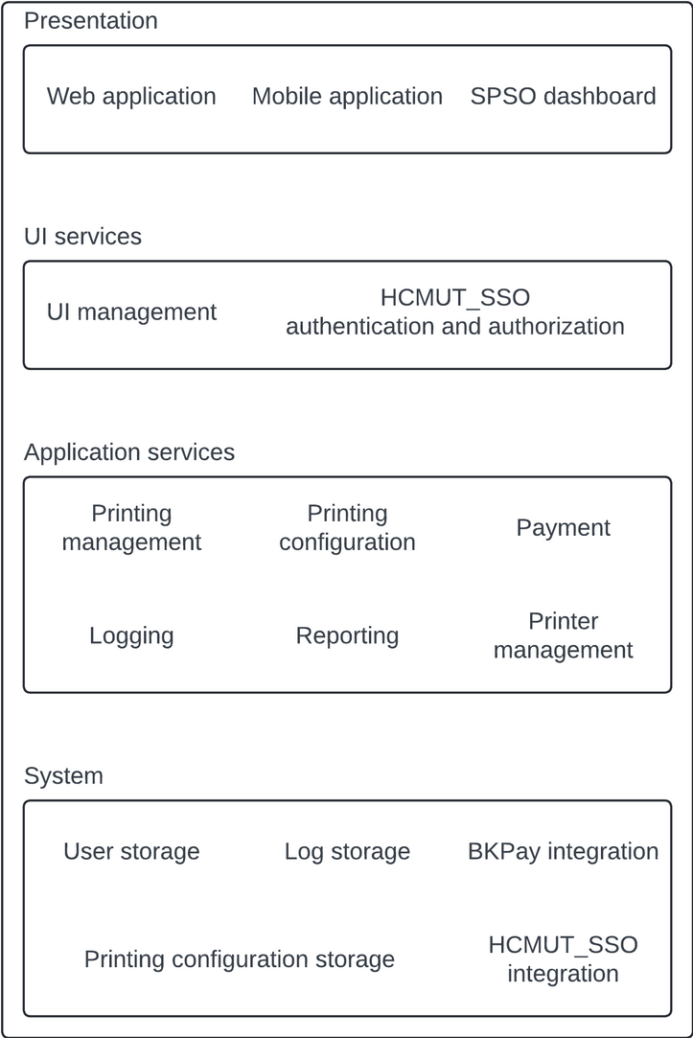
ARCHITECTURE DESIGN
UI Presentation Strategy:
Responsive web app and mobile app
Simple, intuitive interface
Data Storage Approach:
Relational database
Scalable for large student bases
API Management:
Secure external service interaction via REST APIs for HCMUT_SSO and BKPay (payment).
API Gateway ensures efficient routing, logging, and error handling.

Slide 11
DEMO

Slide 12
CONCLUSION
What have been done:
System Architecture: Designed a robust layered architecture for HCMUT-SSPS
Core Features: Implemented printing feature, including document upload, printing configuration, quota management
User Interface: Developed an MVP with a responsive web design
What couldn’t be done:
Advanced features like remote management of printers and detailed analytics reports are not fully implemented due to time constraint
Limited testing due to resource constraints
Lesson learned:
Development: Experience the process to develope a software
Planning: Clear requirement definitions and milestones are crucial for timely delivery
Communication: Effective communication between team members to make a smooth development process

Slide 13
THANK YOU FOR YOUR ATTENTION!

